Slide 1
Strategic Appreciation Deterrence & Prevention Mr. Robert C. Jones, Strategic Advisor, J56 USSOCOM J5 Strategy, Plans, and Policy
“Wars can be prevented just as surely as they can be provoked,
And we who fail to prevent them, must share the guilt for the dead.”
GEN. Omar Bradley
“Repression will provoke rebellion.” Hugh Williamson, American Revolutionary

Slide 2
Problem
The United States currently has a comprehensive scheme of deterrence that is increasingly inadequate to deter states, VEOs, or populations.
State actors operate in “gray zones” to expand their sovereignty.
Non-state actors conduct networked, distributed approaches to unconventional warfare, leveraging political grievances in the populations of others.
Populations are rising up in revolution against governments unable or unwilling to evolve.
Populations are resisting external influence perceived as inappropriate and illegitimate.
What can SOF do to:
Restore effectiveness to deterrence of state actors?
Prevent or deter VEO exploitation of population political grievance?
Assist in preventing revolution, w/out provoking resistance?

Slide 3
National Security Strategy (Feb 2015)
“Build Capacity to Prevent Conflict”
“We will strengthen U.S. and international capacity to prevent conflict among and within states”
“Russia’s violations of Ukraine sovereignty…North Korean provocations…tensions in East and South China Seas….”
“Within states, the nexus of weak governance and widespread grievance allows extremism to take root, violent non-state actors to rise up, and conflict to overtake state structures”
What type of “capacity” is necessary to deter states?
What type of “capacity” is necessary to deter VEOs?
What type of “capacity” is necessary to deter populations?
Is this a capacity we must build in others… or in ourselves??
Notes:
American diplomacy and leadership, backed by a strong military, remain essential to deterring future acts of inter-state aggression and provocation by reaffirming our security commitments to allies and partners, investing in their capabilities to withstand coercion, imposing costs on those who threaten their neighbors or violate fundamental international norms, and embedding our actions within wider regional strategies

Slide 4
SOCOM Concepts
Unconventional Deterrence: A credible threat of unconventional warfare designed to leverage vulnerable populations of state actors we seek to deter.
Deterrence of Irregular Threats (Prevention): Disaggregation of actors relevant to a region where vital interests exist; then designing and implementing a balanced program of varying degrees of encouragement and discouragement across the spectrum to our ends.
Prevention of Natural Things: Applying ecosystem logic to governance systems, recognizing that political conflict is natural, but that by understanding and managing healthy, evolving ecosystems one can reduce the likelihood of catastrophic political conflict.

Slide 5
Strategic Appreciation
Part II: Understanding the Purpose of Each Document
Strategic Appreciation is about understanding the environment and creating a contextual foundation.
Recognize and apply an ecosystems of ecosystems logic
Era of major shifting of power between, among, and within Systems of Governance.
Opportunities and Threats manifest from rapidly evolving “Strategic Energy” within this environment: Rising States, Rising Populations, and a fusion of both.
Increasingly about facilitating changes least dangerous to vital interests as hegemony transitions to multi-polar; and as governance evolves
Broad implications for SOF that help frame the Commander’s vision, priorities, and strategic guidance
Big Bet?
Shift from a focus on reactive, threat-centric perspectives with associated Core Activities (CT, COIN, and FID focused on BPC).
Shift toward more proactive, Energy-centric perspectives with associated approaches related to UW (improving deterrence, disrupting UW of others, and FID focused on our UIR*).
* (UIR: Understanding, Influence, and Relationships with populations, state and non-state actors critical to U.S. interests.)
Slide 2 of 5

Slide 6
SOCOM’s Appreciation of the Strategic Environment
STRATEGIC INSIGHTS
TRENDS
PRODUCE
GENERATES
Potential Energy*
Kinetic Energy**
People matter. Networked populations are increasingly influential and important.
An ecosystem logic is the best lens to understand the environment.
The best strategic metrics will be closely tied to popular perceptions
Potential energy is opportunity – either for us or our adversaries
We can no longer achieve stability through imposing stasis; we must accept a degree of change to influence effectively
Deterrence requires new, creative layers
Insurgency will be more common, and rooted in political grievances – though possibly guided by ideology.
Rapidly
Shifting
Power
Threat
Cyber & Information
Economic Challenge and Fiscal Restraints
Globalization
Natural Resource Pressures / Demand
Science / Technology
Shifting Demographics / Urbanization
Opportunity
State
Potential
Energy
(Power +
Interest)
“Conflict Between”
“Gray zone” / illegal competition
Eroding deterrence
Policy friction/gaps
States
(Between)
Non-State Actors
(Toward)
STRATEGIC OPPORTUNITY:
Shape potential energy by deepening our understanding, developing relationships, providing early warning of problems, and cultivating influence to create time and space and preserve options.
“Conflict Across & Among”
Trans-regional challenges
Internal instability + external exploitation
Hybrid of conflicts “between” & “within”
Populations
(Toward)
“Conflict Within”
Slowly
Adjusting
Privilege
Population
Potential
Energy
(Power +
Grievance)
Governance gaps
Instability and revolution
Popular perceptions of legitimacy vs. government’s legality.
*Potential Energy: Occurs when a state’s or population’s power is greater than its privilege; it will seek to resolve the perceived imbalance.
**Kinetic Energy: Occurs when a state or population acts illegally or violently to seize privilege commensurate with its perceived power.
As of: 18 Dec 15

Slide 7
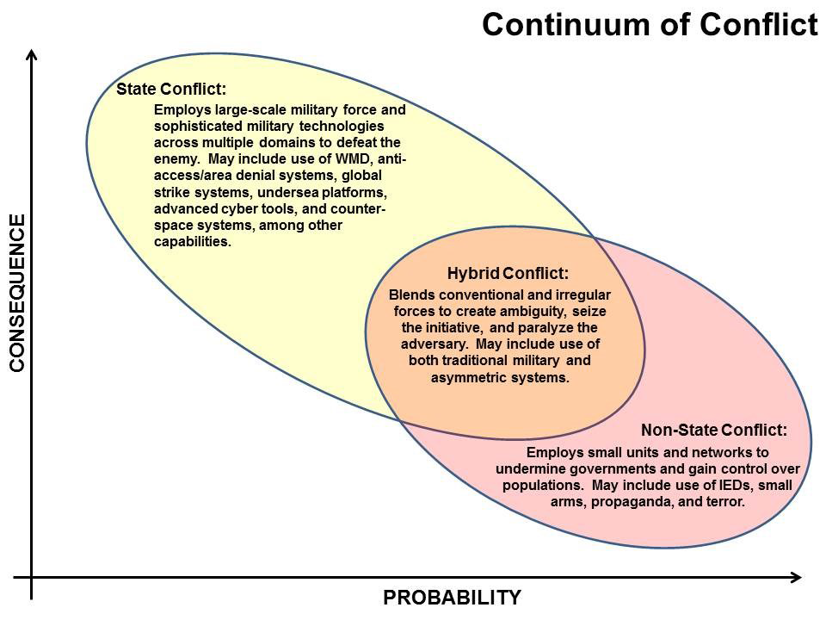
Continuum of Conflict In the Context of Strategic Appreciation
“Between” – Clausewitzian war. Strategic Energy is a fusion of Power and Interest. As deterrence erodes, and diplomacy and hybrid conflict approaches fall short, rising powers will resort to war to secure interests perceived as vital or appropriate to their enhanced status. Similarly, declining powers will do the same to retain what they perceive as their sovereign right. Sovereignty follows power, and this is “the final argument of kings.”
PE is key for all: Right purpose, right place, right audiences
“Among” – Unconventional Warfare. Strategic energy is Power and Interest for the UW actor, and Power and Grievance for the identity-based population(s) leveraged by the UW actor. Interests between the two rarely align; these are relationships of necessity and rarely endure beyond either party achieving its interest-based goals. One need not be a state (AQ, ISIS) to wage UW.
“Within” – Non-War Civil Emergency.
Strategic Energy is a fusion of Power and Grievance. This is Illegal politics - a form of democracy that need not be violent. Durable solutions require governance to evolve to establish trust with the aggrieved population. The nature of interventions is that they erode legitimacy of any solution, and must be characterized to mitigate this effect.
Continuum of Conflict

Slide 8
State Adversaries (“Between”) In the Context of the Strategic Appreciation
“Deter, Deny, and Defeat State Adversaries”:
Major warfare between states is as likely today as it was on the eve of WWI.
Like then, major shifts of power are taking place both between and within states.
Like then, major powers are bound by alliances shaped for an obsolete environment.
Like then, rising powers operate aggressively in the gray to expand sovereignty.
Deterrence is the primary mission now, but traditional approaches to deterrence are inadequate to the current strategic environment.
Conventional and nuclear deterrence are important, but are multiplied by our perceived will to employ. There is little potential gain from enhancing these expensive lines of deterrence if the perceived will remains constant.
Will to engage in major state warfare is low in general, doubly so when “gray” approaches intentionally do not trip clear triggers for war. This is appropriate and unlikely to change.
Economic sanctions negatively impact populations more than governments.
SOF can enhance comprehensive deterrence at very low opportunity cost.
Today’s rising states possess large, identity-based populations with tremendous exploitable strategic energy composed of rising power and suppressed grievance.
By creating a credible threat of UW, an activity we are perceived as having the will to employ, SOF can help restore effectiveness to our comprehensive deterrence.
Posturing SOF for deterrence postures SOF for major conflict as well.

Slide 9
Allies and Partners (“Within”) In the Context of the Strategic Appreciation
“Strengthen Our Global Network of Allies and Partners”:
Does building security force capacity “strengthen,” or does it enable governments to ignore reasonable concerns in ways that makes the exploitable strategic energy worse? How do we help reduce this energy?
BPC in situations where we respect host limitations and work to build host professionalism and legitimacy in eyes of their population have worked well.
BPC in situations where the host is severely lacking in popular legitimacy and where we place few constraints on our actions have been strategic disasters (Vietnam, Afghanistan and Iraq).
Do efforts to help “disrupt, degrade and defeat” revolutionary VEOs for a partner or ally make them more, or less susceptible to UW by international VEOs who’s goals are truly adverse to US interests?
US Declaration of Independence recognizes the universal right and duty to revolution. This is our original “value” as a nation. CT constructs like “AQAA” have an attractive tactical logic, but are strategically counter-productive.
How do we best help partners and allies faced with internal revolution? How can we act as a facilitator of positive evolution designed to reduce the exploitable strategic energy in these situations? How can we better avoid undermining host popular legitimacy, or increasing the strategic energy and directing it at ourselves?

Slide 10
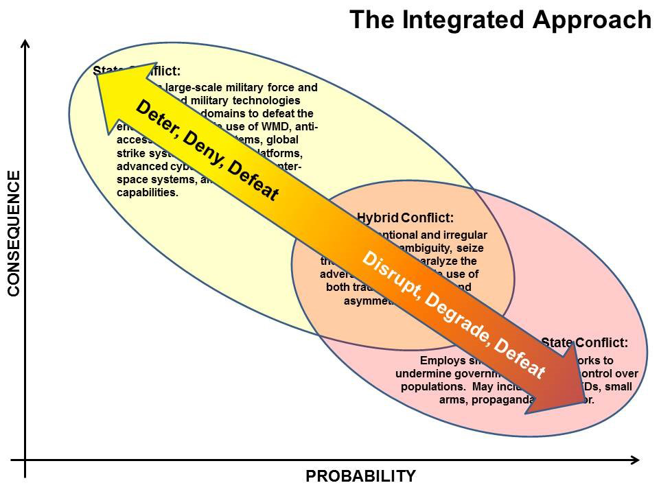
Implications for SOF Strat App Applied to NMS “Integrated Approach”
“Between” – Clausewitzian war. The entire spectrum of SOF Core Activities apply to Deny or Defeat a state actor. SOF contributes best to a comprehensive scheme of deterrence by conducting preparation of the environment so as to establish a credible threat of UW. These actions may be covert and within the denied space of the targeted state, but increasingly will be transparent, maximizing global human domain and cyber tools.
“Among” – Unconventional Warfare. C-UW provides the most appropriate strategic framework for addressing the UW efforts of state or non-state actors. C-UW provides new priorities and purposes to tasks currently conducted under a CT rubric, and should produce better strategic results. All actions are influence actions first, with tactical results and risk secondary. Uses UW, not CT, on revolutionaries. Efforts must reduce the strategic energy.
“Within” – Non-War Civil Emergency.
Recognizes COIN as a domestic operation and the erosive effect of intervention on the popular legitimacy necessary for stability. Adheres to narrow authorities granted by host and facilitates evolution, not preservation, of governance. Efforts to “defeat” insurgents feed strategic energy
The Integrated Approach

Slide 11
Unconventional Deterrence
Where we can’t sell UW, we can probably sell UD
Does not require clandestine operations among target population
Engage populations that extend into permissive space
Engage diasporas
Employ full range of cyber tools, social media, etc.
Supplements, does not supplant, current deterrence
Provides productive focus to Phase 0 SOF operations
Produces a deterrent effect now
Postures SOF for rapid, effective Phase 3 operations
Consistent with pre-SOCOM ARSOF focus 1950s-1980s

Slide 12
Deterrence of Irregular Threats (Prevention) Full-Spectrum Deterrence
The following is a draft framework to aid in current operations; from Irregular Warfare, to Response, to Deterrence
The intent of the framework is to help visualize, and thereby better account for, the full complexities of the broad range of empowered actors on today’s evolving world stage; as well as the full range of options that can be employed to facilitate the peaceful pursuit of U.S. National Interests.
The immediate goal is to expand the strategic dialog as to how the U.S. best approaches:
To Defeat, Disrupt, or Deter all threats to National Interests,
Deterrence of Irregular Threats in particular, and
The next chapter of “GWOT” and
The operationalization of Irregular Warfare
“Apart from the Special Forces and some dissident colonels, however, for decades there has been no strong,
deeply rooted constituency inside the Pentagon or elsewhere for institutionalizing the capabilities necessary
to wage asymmetric or irregular conflict.” Robert M. Gates, Secretary of Defense

Slide 13
Key Terms
Positive Engagement: Encourage
Promote - (Cognitive) Create beliefs which support desired behavior
Enable - (Physical) Help create conditions to allow a state or organization get started implementing desired behavior
Enhance* - (Physical) Help them to perform desired behavior more effectively on their terms
Negative Engagement: Discourage
Deter - (Cognitive) Create belief not in best interest to attack.
Preclude - (Physical) Deny opportunity to successfully attack.
Preempt* - (Physical) Deny ability to successfully attack.
* Third Level Engagement (Preempt or Enhance) should be applied with caution
Due to the increased risk of creating perceptions of inappropriate legitimacy for
“Enhance” or unintended provocation for “Preempt.”

Slide 14
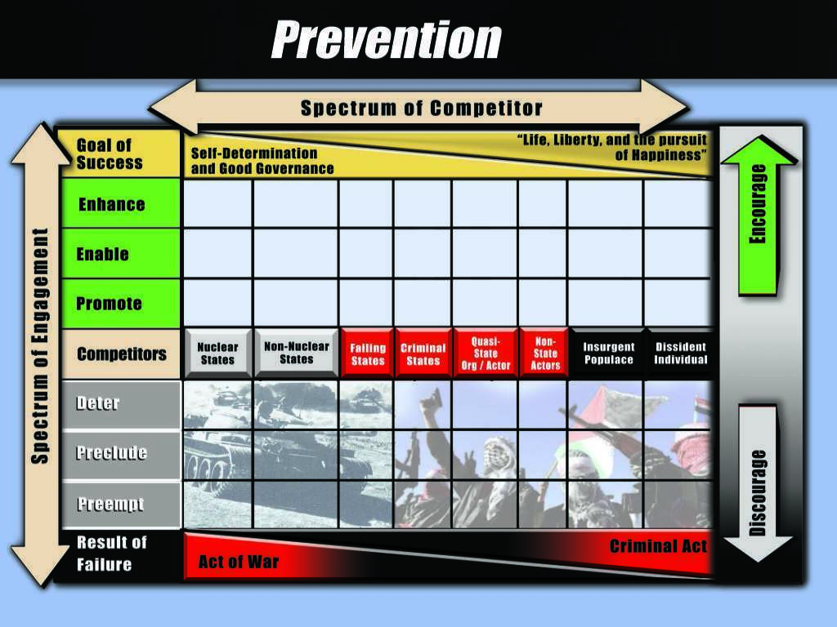
Think Holistically
Are we as neutral as possible between the parties?
Have we looked for shared interests equally with every party involved?
Are we creating new problems in the process?

Slide 15
Prevention of Natural Things
Apply ecosystem logic.
Political conflict is a natural thing.
The prevention of natural things, like wildfire or cancer or human conflict, recognizes several hard realities:
These things cannot be eliminated, and have essential roles in their respective ecosystems.
The better one understands and nurtures ecosystem health the less destructive these things are.
The US needs to form a more accurate understanding of the ecosystem of governance, and work to ensure that systems most important to our vital interests are as healthy as possible. Such an understanding will provide new priorities for when and how we engage with the ecosystems of others. This shapes the where, what and why of persistent engagement.
Sometimes no treatment at all is the best course. We must guard against over engagement.
Notes:
US post-Cold War foreign policy and response to “Big 5”
Understand ecosystem and manage for higher order effects
Political conflict is natural; excessive external control disrupts nature
Shape evolutionary change to avoid revolutionary change
VEOs play a role, and small conflicts help prevent large

Slide 16
The Yellowstone Lesson “Don’t Mess with Mother Nature”
Maintain the park as is for future generations
Capture/Kill all predators to wildlife and humans
Suppress wildfire to prevent destruction of forest
Result: Tactical success fomenting strategic failure
Stasis is not natural and takes tremendous energy to sustain
Predator removal resulted in overpopulation of elk, disease, and destruction of riparian zones
Fire suppression fostered disease and made forest susceptible to catastrophic fire.
Sought to understand and apply ecosystem
Allow but mitigate/shape predators and fire
Recognize influenced change > controlled stasis

Slide 17

Strategic Transition – A Proposal Re-Thinking US Global Leadership, and SOF’s Role
Post-Cold War Era:
“Playing Not To Lose”
Emergent Strategic Environment:
“Playing To Win”*
* What is “winning”?
Policy Characterized By:
Defending The Status Quo
Creating Gray Zones
Reactive & Threat-Centric
Policy Characterized By:
Facilitating Positive Change
Creating Positive Influence
Proactive & Interest-Centric
SOF Operations Characterized By
Regional, Threat-Centric Approaches
Big Counterterrorism (CT)
Big Building Partner Capacity (BPC)
Big Counter-Insurgency (COIN)
SOF Operations Characterized By Trans-Regional
Energy-Centric Approaches:
Countering Unconventional Warfare (C-UW)
Tailored Foreign Internal Defense (FID)
Tailored Counterterrorism (CT)
Primary Effects Characterized By:
Defeat / Disrupt / Contain Threats
Sustain Allies & Partners
Suppresses localized symptoms,
but increases negative Strategic Energy
Primary Effects Characterized By:
Reduces Strategic Energy across the region
Develop Understanding, Influence & Relationships
Disrupt / Mitigate Networks and Violence
Create Time and Space

Slide 18
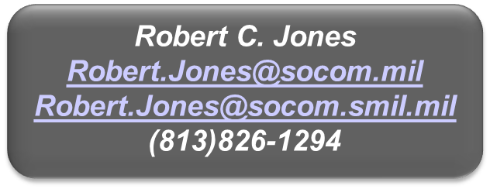
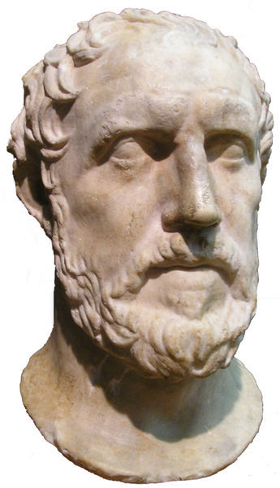
Questions?
Strategic Understanding
“Of all manifestations of power, restraint impresses men the most.” Thucydides

Slide 19
Strategic Prevention
A comprehensive approach for advancing US policies and securing US interests in a manner designed to reduce the provocative side-effects of those actions.
Requires planners to look beyond the specific place and solution to any particular problem and to then balance positive and negative approaches across all relevant and significant parties likely to be affected.
Seeks to appreciate perceptions from the perspectives of those affected by our actions and guards against overly presupposing US perspectives, interests or values onto others.

Slide 20
Considerations
Align are our messages and actions
Alignment builds influence
Divergence expends influence
Design the operations to tell the intended story
Commander’s approve a message along with a mission
Employ message alignment as weighted COA criteria
Consider a prioritized and complete scope of important audiences (foreign and domestic, formal and informal)
Local
Regional
Domestic
Global

